Slide 1
Welcome To JnanaMarga Internship Program

Slide 2
Welcome To JnanaMarga Internship Program
Few Things to keep in mind
Have a Learning attitude
Communicate your problems and difficulties
Help each other
While Learning something new do not use AI
Google is your best friend!!

Slide 3

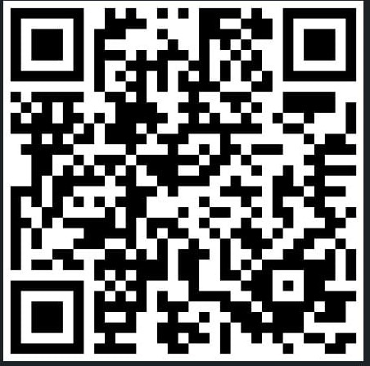
Who Am I
LinkedIn
Exchange Student in South America!

Slide 4
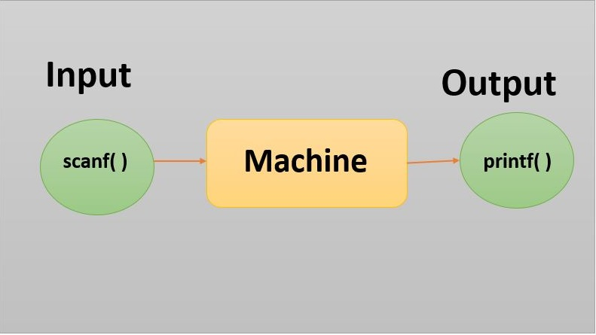
PROGRAMMING LANGUAGE

Slide 5
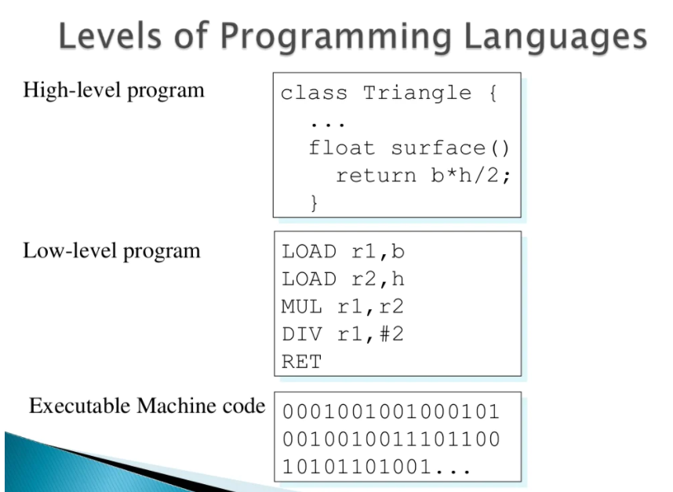

Slide 6
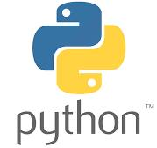
Welcom To Python Programming Langauge

Slide 7
WHAT IS A PROGRAMMING LANGUAGE ?
A programming language is a vocabulary and set of grammatical rules for instructing a computer or computing device to perform specific tasks.
The term programming language usually refers to high-level languages, such as BASIC, C, C++, PYTHON , Java and FORTRAN
• Each language has a unique set of keywords (words that it understands) and a special syntax for organizing program instructions.

Slide 8
WELCOME TO PYTHON
PYTHON is a high level and an object oriented programming language.
PYTHON language is used in a wide range of work .
For example :
Web Development
Software development
Scripting
AI/ML
Mathematics etc.
BENEFITS OF PYTHON OVER OTHER LANGUAGES
Can work across a range of different platforms (for eg. Linux , windows and MAC)
Easy syntax which is similar to the English language.
Automatic memory management.
No requirement of a compiler. PYTHON is a self interpreted language.
Shorter, more flexible codes
One doesn’t not need to specify the data types.

Slide 9
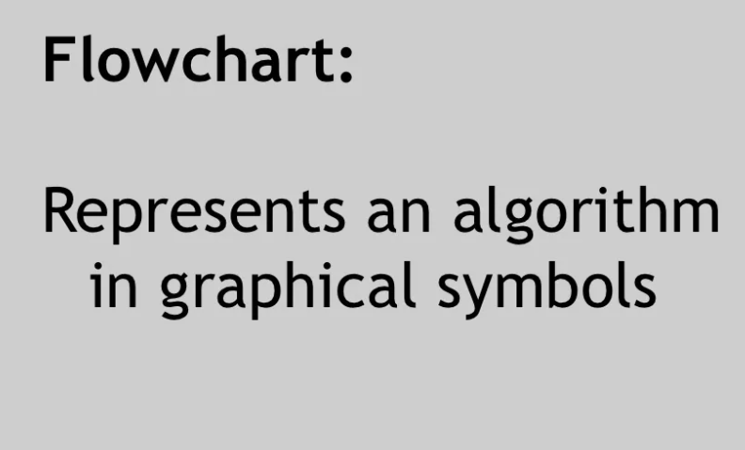

Slide 10
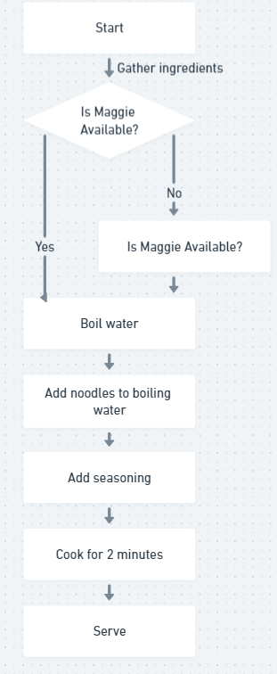

Slide 11
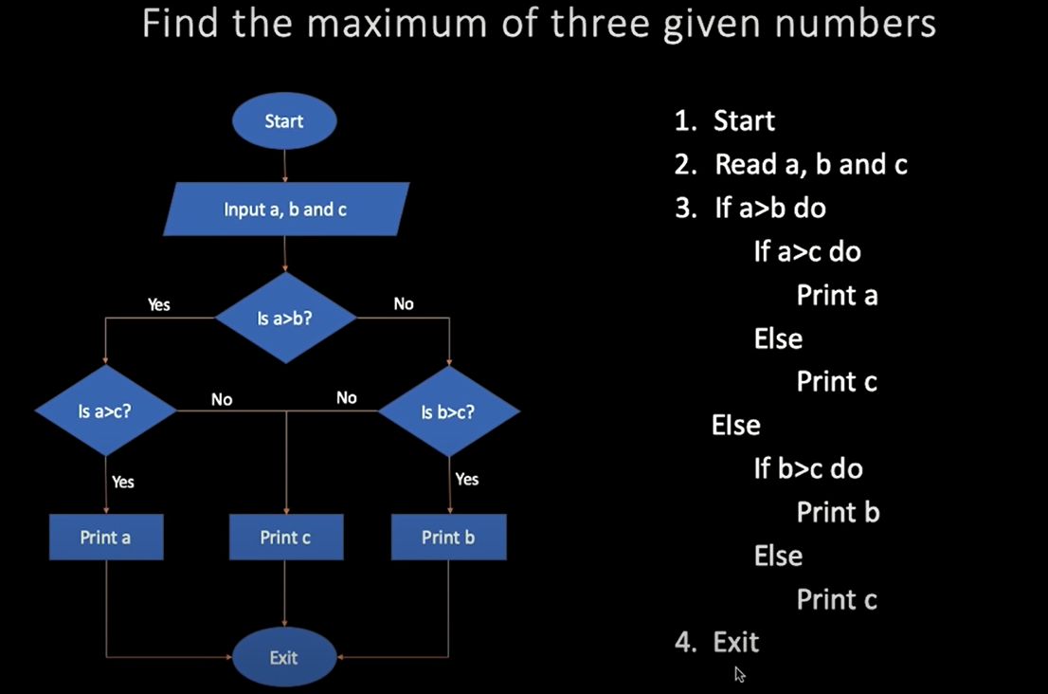
EXAMPLES FOR PSEUDOCODE – 1

Slide 12
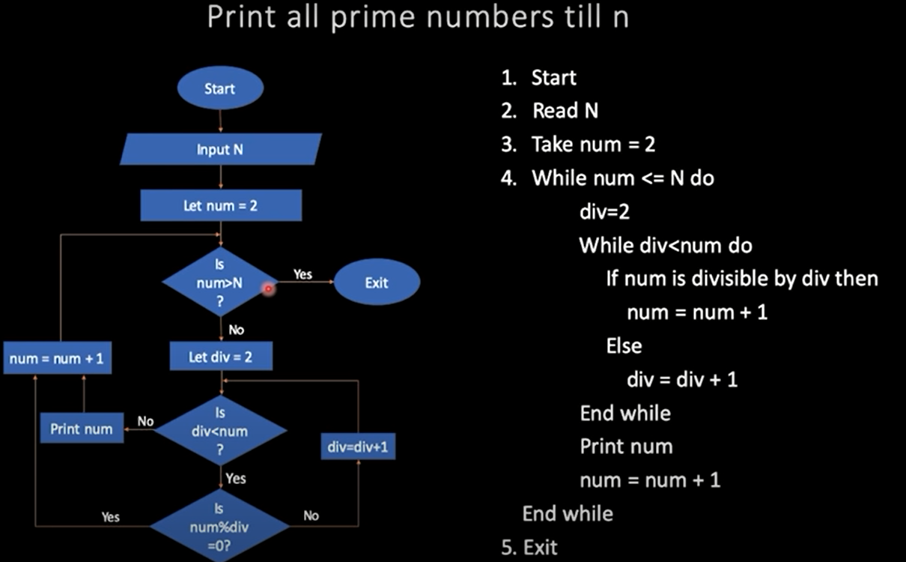
EXAMPLES FOR PSEUDOCODE – 1

Slide 13
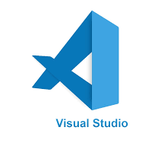
Implementation
basic arithmetic +prints + comments + variables + data Types
+

Slide 14
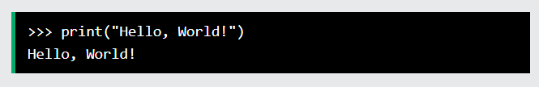
Execute Python Syntax
As we learned in the previous page, Python syntax can be executed by writing directly in the Command Line:
Or by creating a python file on the server, using the .py file extension, and running it in the Command Line:

Slide 15
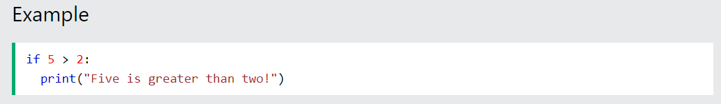
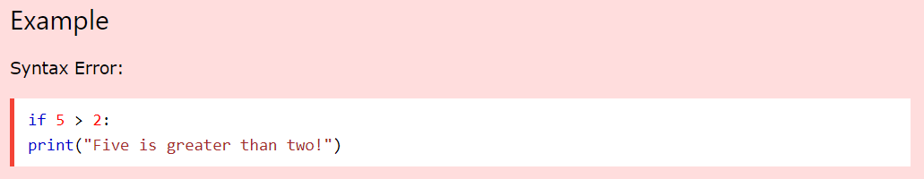
Python Indentation
Indentation refers to the spaces at the beginning of a code line.
Where in other programming languages the indentation in code is for readability only, the indentation in Python is very important.
Python uses indentation to indicate a block of code
Python will give you an error if you skip the indentation:

Slide 16
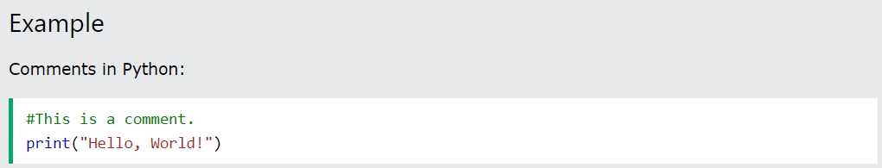
Comments
Python has commenting capability for the purpose of in-code documentation.
Comments start with a ‘#’ , and Python will render the rest of the line as a comment:
Comments can be used to explain Python code.
Comments can be used to make the code more readable.
Comments can be used to prevent execution when testing code.
Comments can be placed at the end of a line, and Python will ignore the rest of the line:

Slide 17
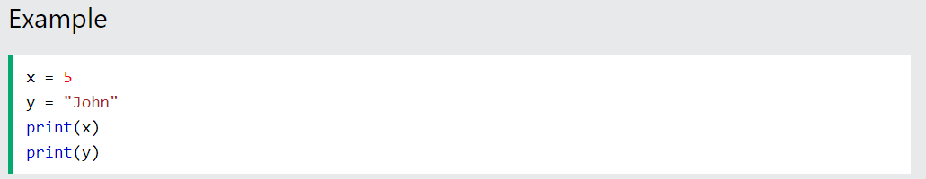
VARIABLES
Variables are containers for storing data values.
Creating Variables
Python has no command for declaring a variable.
A variable is created the moment you first assign a value to it.

Slide 18
Variable Names
A variable can have a short name (like x and y) or a more descriptive name (age, carname, total_volume).
Rules for Python variables :
A variable name must start with a letter or the underscore
( _ ) character.
A variable name cannot start with a number.
A variable name can only contain alpha-numeric characters and underscores (A-z, 0-9, and _ )
Variable names are case-sensitive (age, Age and AGE are three different variables)

Slide 19
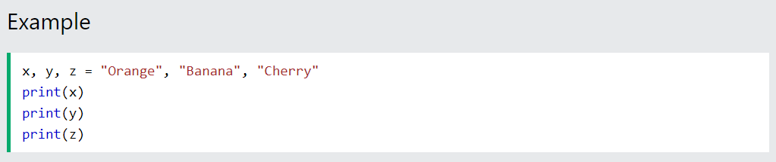
Python Variables - Assign Multiple Values
Many Values to Multiple Variables
Python allows you to assign values to multiple variables in one line:
Note: Make sure the number of variables matches the number of values, or else you will get an error.

Slide 20
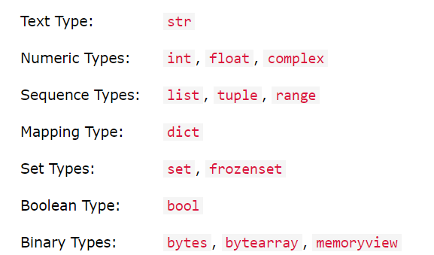
Python Data Types
Built-in Data Types
In programming, data type is an important concept.
Variables can store data of different types, and different types can do different things.
Python has the following data types built-in by default, in these categories:

Slide 21
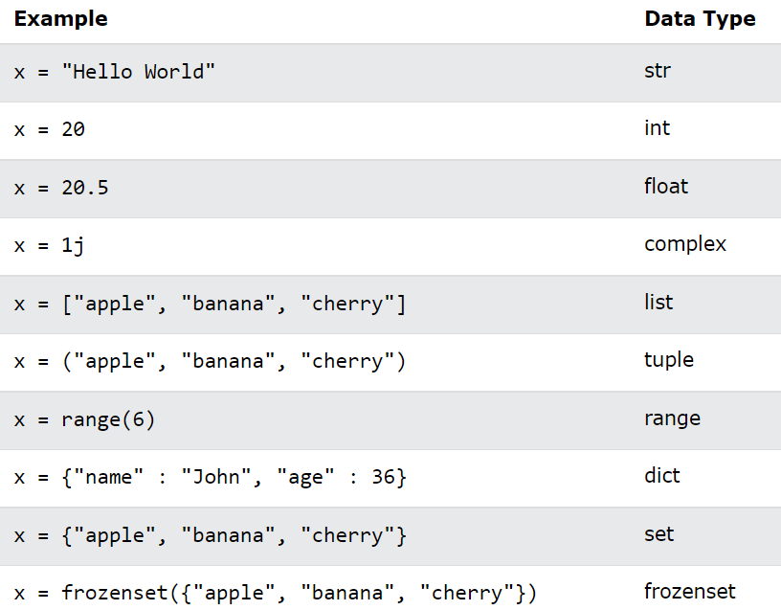
Setting the Data Type
In Python, the data type is set when you assign a value to a variable:

Slide 22
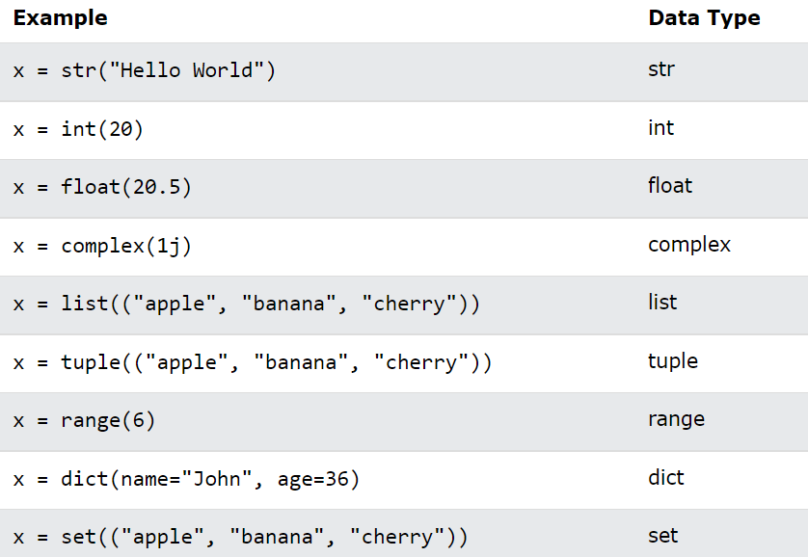
Setting the Specific Data Type
If you want to specify the data type, you can use the following constructor functions:

Slide 23
Todays Task
Download and Setup VsCode and Python in your computer/Laptop

Slide 24
Thanks

